Slide 1
DATA SCIENCE
11 WEEK PART TIME COURSE
Week 7 - Bonus Round
Saturday 7th May 2016

Slide 2
AGENDA
Review of all material so far (Including Models, PCA, Bias-Variance Tradeoff, Data Considerations, Cross-Validation)
Modelling Case Study
Text Analysis
Web Scraping
Prepping Data
Geodata Handling
Other Questions / General Discussion
Projects

Slide 3
REVIEW
DATA SCIENCE PART TIME COURSE

Slide 4
REVIEW - WEEK 1
DATA SCIENCE PART TIME COURSE

Slide 5
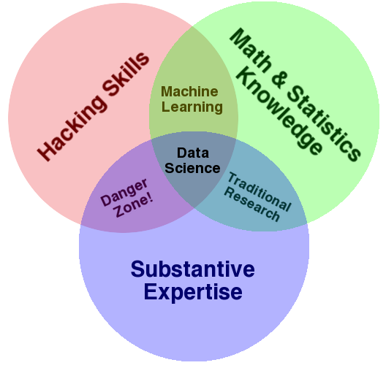
CONTENT PHILOSOPHY
Multidisciplinary Investigations
Models and Methods for Data
Computing with Data
Pedagogy
Tool Evaluation
Theory
Data Science: An Action Plan for Expanding the Technical Areas of the Field of Statistics
William S. Cleveland
Drew Conway’s
Data Science Venn Diagram

Slide 6
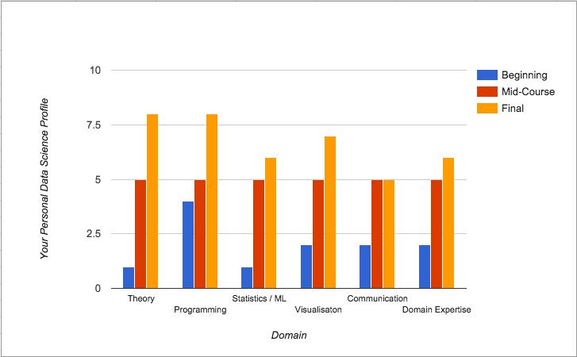
CONTENT PHILOSOPHY

Slide 7
HOW DO WE ACTUALLY COLLABORATE WITH GIT?
Course Repo
github.com/coolstudent/SYD_DAT_3
Course Repo
github.com/ihansel/SYD_DAT_3
1. Fork
6. Pull Request
2. Clone
5. Push
CoolStudent Laptop
3. Update a file
4. Commit

Slide 8
REVIEW - WEEK 2
DATA SCIENCE PART TIME COURSE

Slide 9
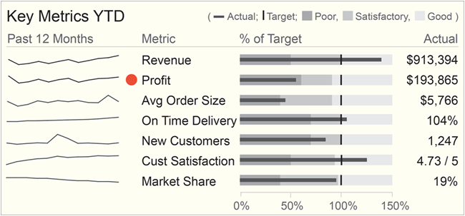
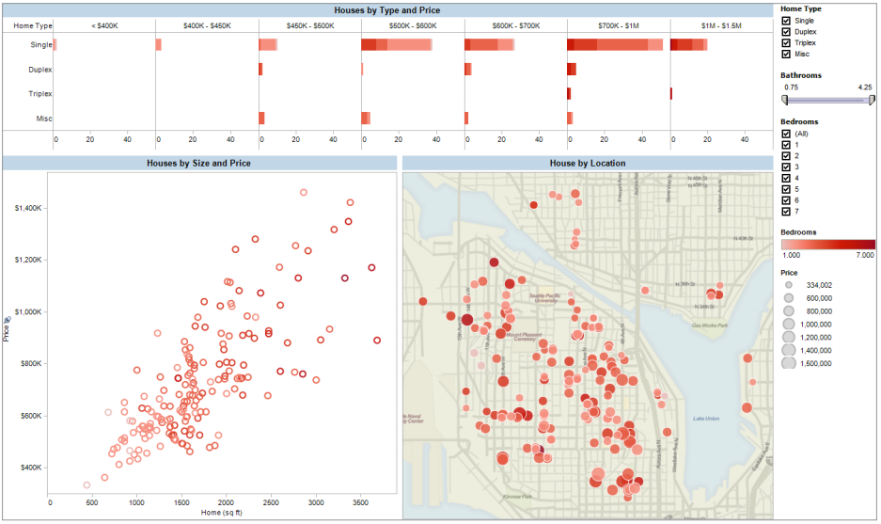
WHY VISUALISE DATA?
Reporting
Dashboards and Business Intelligence
Know the questions you want answers to
Can detect changes from the norm
Good for taking a 30,000 foot view of the problem

Slide 10
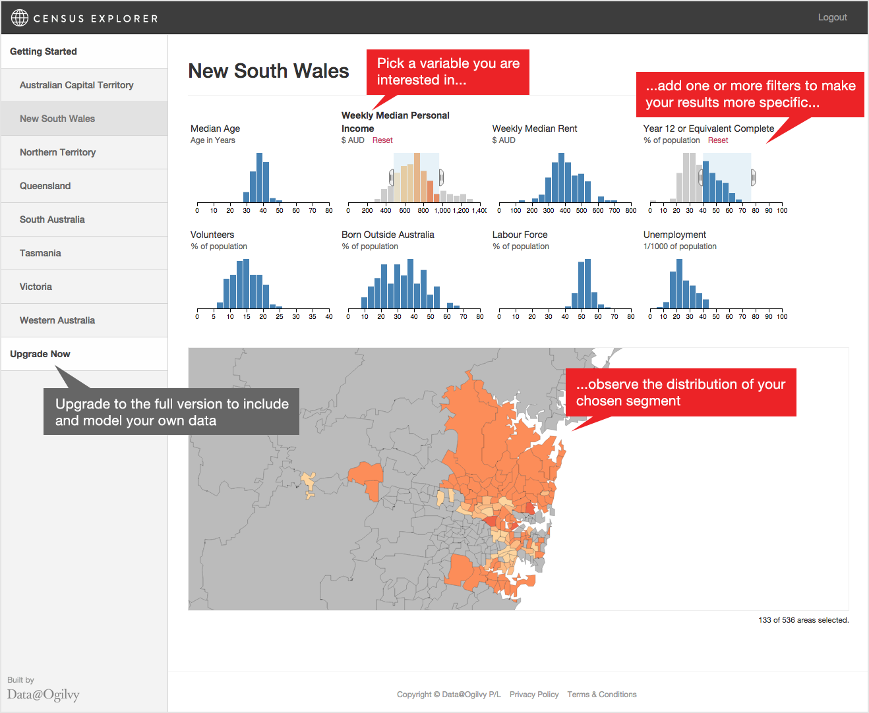
WHY VISUALISE DATA?
Exploring
Exploratory Data Analysis
Combines multiple data sources for single view of a problem
Technical analysis of data
Combined with modelling allows for the discovery of new problems and solutions

Slide 11
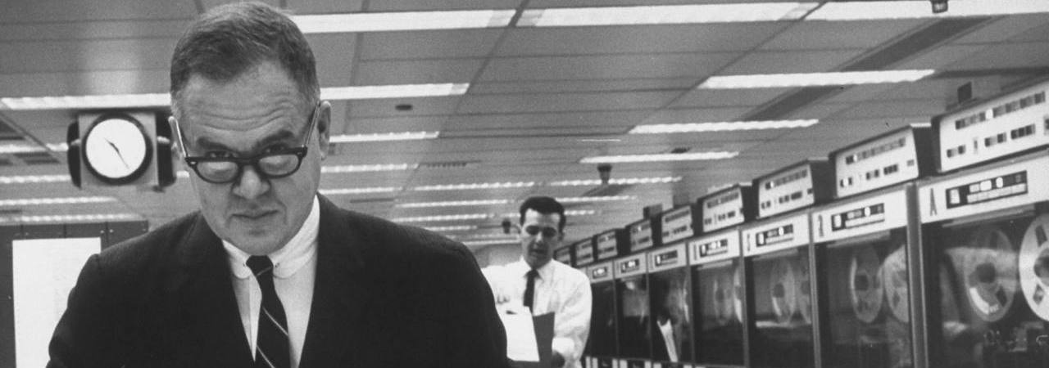

USING DATA SCIENCE PACKAGES
The greatest value of a picture is when it forces us to notice what we never expected to see.
John W. Tukey.
Exploratory Data Analysis. 1977.
DATA SCIENCE PART TIME COURSE

Slide 12
SUPERVISED LEARNING
We want to predict some value, let’s call it y, based on some observed data we have, let’s call that x.
We will use statistical learning to estimate a function that approximates y based on the input, x.
y is also called; label, dependent variable, target
x is also called; predictor, independent variable, features

Slide 13
SUPERVISED LEARNING - REGRESSION & CLASSIFICATION
If the y variable is numeric then we have a regression problem - we are trying to predict a continuous number
If the y variable is a category (for example trying to predict a type of flower) the we have a classification problem - we are trying to classify what group that y belongs to.

Slide 14
UNSUPERVISED LEARNING
We want to find some underlying structure or patterns in the data but in this case we don’t have any labeled data.
So for example, if we have a large group of customers but would like to separate them into groups (or clusters) to better target them.

Slide 15
LINEAR REGRESSION
y=Xβ+ϵ
y = target variable
X = input variable
β = coefficients
ϵ = error term
Note, one of our input variables can be 1 so we have an intercept parameter

Slide 16
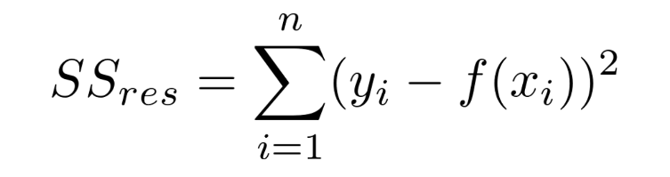
ORDINARY LEAST SQUARES
y=Xβ+ϵ
Basically, what we are trying to do is minimise the Residual Sum of Squares. This is the Sum of the squared difference between our observed value and the value from the model

Slide 17
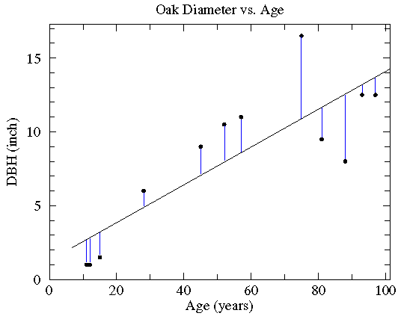
ORDINARY LEAST SQUARES

Slide 18
REVIEW - WEEK 3
DATA SCIENCE PART TIME COURSE

Slide 19
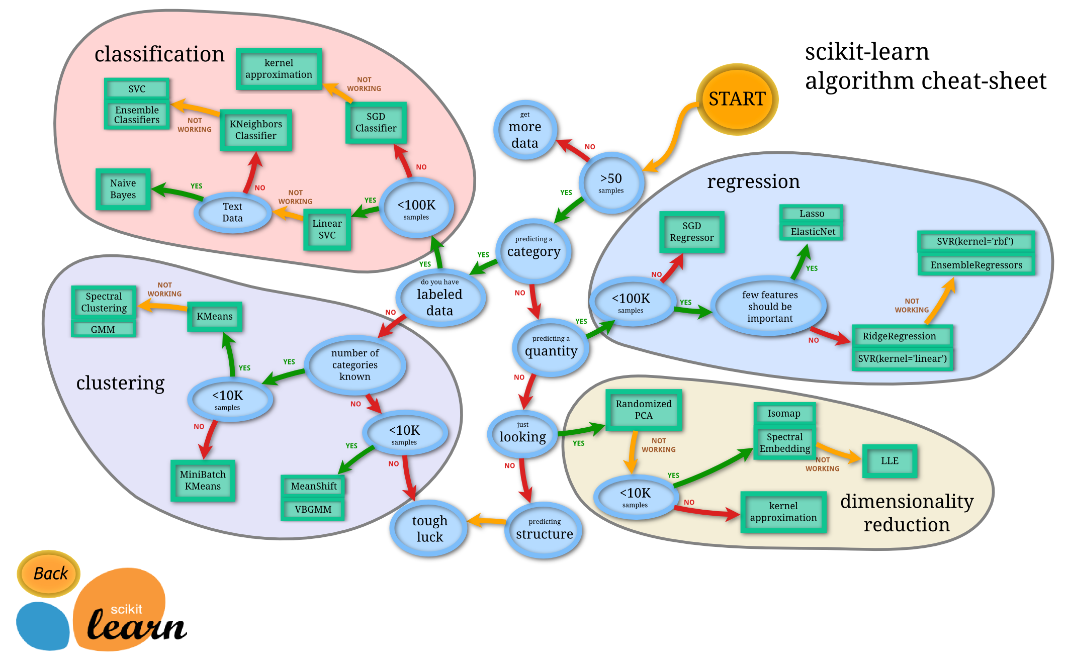

Slide 20
LOGISTIC REGRESSION
We want to build a classifier that correctly identifies which class our target variable y belongs to given our input variable x.
Why not use the linear regression model?
y=Xβ+ϵ

Slide 21
LOGISTIC REGRESSION
If we only have a binary response variable (0 or 1) it might make sense… BUT we can have our estimated value of y > 1 or y < 0 … which doesn’t make sense.
What of the case where we have more than one class? Linear regression cannot easily handle these cases.
We want a classification method that can handle these cases and give us results we can easily interpret.

Slide 22
TRAINING ERROR
Q: What’s wrong with training error?
Thought experiment:
Suppose we train our model using the entire dataset.
Q: How low can we push the training error?
We can make the model arbitrarily complex (effectively “memorizing” the entire training set).
A: Down to zero!

Slide 23
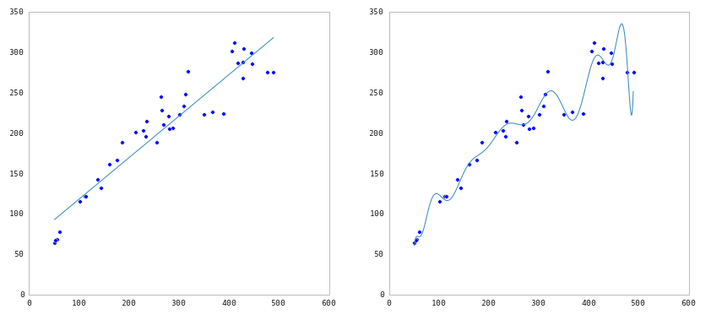
TRAINING ERROR

Slide 24




TEST SET APPROACH
Q: How can we make a model that generalizes well?
1) split dataset
2) train model
3) test model
4) parameter tuning
5) choose best model
6) train on all data
7) make predictions
on new data
NOTE
This new data is called out of sample data. We don’t know the labels for these OOS records!
We want to estimate OOS prediction error so we know what to expect from our model.
training set
model
test set
new data
dataset

Slide 25
CROSS VALIDATION
Steps for K-fold cross-validation:
Randomly split the dataset into K equal partitions.
Use partition 1 as test set & union of other partitions as training set.
Calculate test set error.
Repeat steps 2-3 using a different partition as the test set at each iteration.
5) Take the average test set error as the estimate of OOS accuracy.

Slide 26
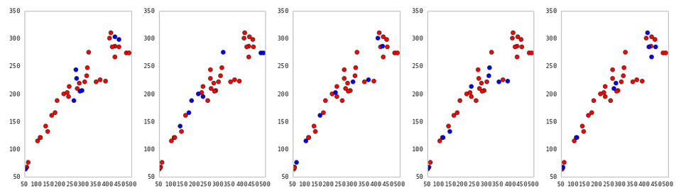
CROSS VALIDATION
5-fold cross-validation: red = training folds, blue = test fold
Source: http://nbviewer.ipython.org/github/fonnesbeck/Bios366/blob/master/notebooks/Section6_3-Model-Selection-and-Validation.ipynb

Slide 27
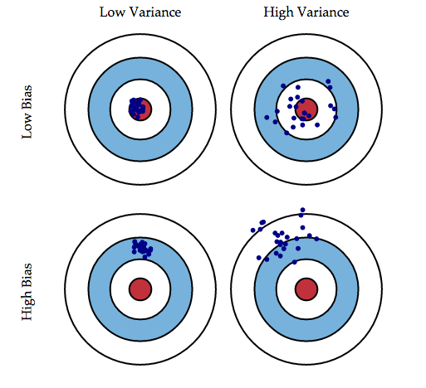
BIAS - VARIANCE TRADEOFF
￼

Slide 28

BIAS - VARIANCE TRADEOFF

Slide 29
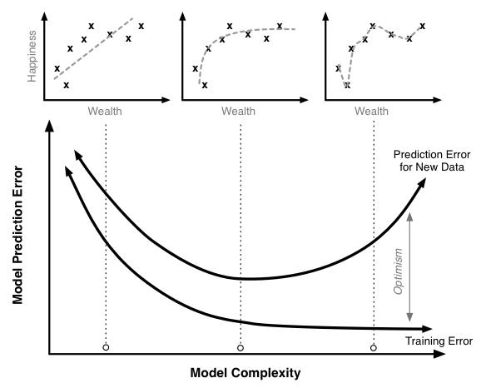
BIAS - VARIANCE TRADEOFF

Slide 30
REVIEW - WEEK 4
DATA SCIENCE PART TIME COURSE

Slide 31
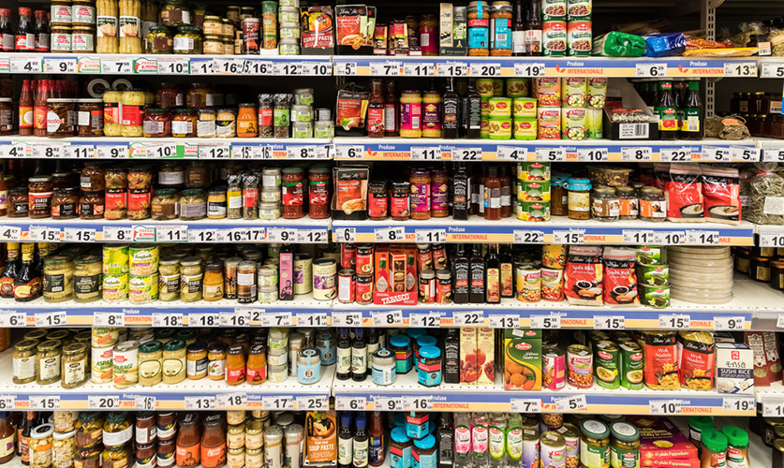
AGENDA
GUEST SPEAKER - Rainer Hillermann !
Motivation / Review
What is Regularization?
Why use Regularization
Lab
Discussion

Slide 32
SUBSET SELECTION
We could fit a separate linear regression model for every combination of our features.
But what happens when we have a large number of features?
Computation time becomes a factor and we also need to consider that as we include more features we are increasing the chance we include a variable that doesn’t add any predictive power for future data.

Slide 33
HOW DOES REGULARIZATION WORK?
A tuning parameter lambda (or sometimes alpha) imposes a penalty on the size of coefficients.
Instead of minimizing the "loss function" (mean squared error), it minimizes the "loss plus penalty".
A tiny alpha imposes no penalty on the coefficient size, and is equivalent to a normal linear model.
Increasing the alpha penalizes the coefficients and shrinks them toward zero.

Slide 34
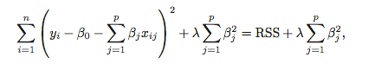
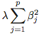
RIDGE REGRESSION
Ridge Regression is similar to least squares, except we include a penalty term,
the λ term is a tuning parameter. When it is zero we get least squares,
as it increases the term, (the shrinkage penalty) has more of an
impact and the coefficients will approach zero.

Slide 35
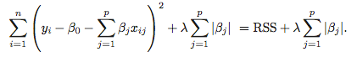
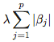
LASSO REGRESSION
Lasso Regression is similar to Ridge Regression, except we have the absolute value of beta in our penalty term,
the λ term is a tuning parameter. When it is zero we get least squares,
as it increases the term, (the shrinkage penalty) has more of an
impact and the coefficients will equal zero.

Slide 36
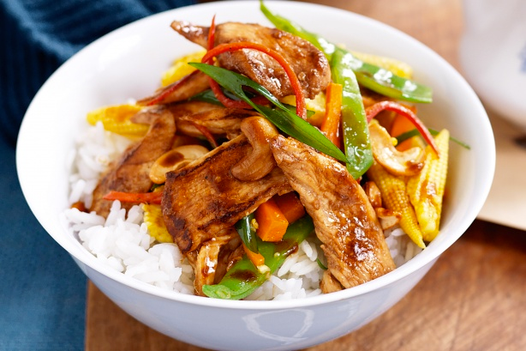
AGENDA
GUEST SPEAKER - Rainer Hillermann !
Motivation / Review
What is Regularization?
Why use Regularization
Lab
Discussion

Slide 37
WHAT IS A CLUSTER?
Recall unsupervised learning is when we are trying to find interesting patterns or groups in our data. We don’t have a variable we are trying to predict (a Y value).
Clustering aims to discover subgroups in our data where the points are similar to each other. So we have a collection of groups and all points belonging to the same group are similar. Points in different groups are different to each other.
We have to decide what variables we will construct the groups on. What makes them different (or similar)?

Slide 38
WHY WOULD WE CLUSTER DATA?
Marketing teams might want to group customers into like groups as a way of summarising the data

Slide 39

WHY WOULD WE CLUSTER DATA?
Financial groups may want to group transactions into like groups as a way to find unusual payments

Slide 40
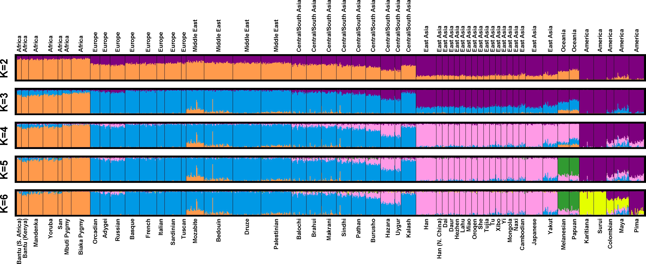
WHY WOULD WE CLUSTER DATA?
Genetics data can be clustered to identify ancestry

Slide 41
KMEANS ALGORITHM
1) Choose k initial centroids
2) For each point:
- find distance to each centroid
- assign point to nearest centroid
3) Recalculate centroid positions
4) Repeat steps 2-3 until stopping criteria met
x₁
x₂

Slide 42
KMEANS ALGORITHM
1) Choose k initial centroids
2) For each point:
- find distance to each centroid
- assign point to nearest centroid
3) Recalculate centroid positions
4) Repeat steps 2-3 until stopping criteria met
x₁
x₂

Slide 43
KMEANS ALGORITHM
1) Choose k initial centroids
2) For each point:
- find distance to each centroid
- assign point to nearest centroid
3) Recalculate centroid positions
4) Repeat steps 2-3 until stopping criteria met
x₁
x₂

Slide 44
KMEANS ALGORITHM
1) Choose k initial centroids
2) For each point:
- find distance to each centroid
- assign point to nearest centroid
3) Recalculate centroid positions
4) Repeat steps 2-3 until stopping criteria met
x₁
x₂

Slide 45
KMEANS ALGORITHM
1) Choose k initial centroids
2) For each point:
- find distance to each centroid
- assign point to nearest centroid
3) Recalculate centroid positions
4) Repeat steps 2-3 until stopping criteria met
x₁
x₂

Slide 46
KMEANS ALGORITHM
1) Choose k initial centroids
2) For each point:
- find distance to each centroid
- assign point to nearest centroid
3) Recalculate centroid positions
4) Repeat steps 2-3 until stopping criteria met
x₁
x₂

Slide 47
KMEANS ALGORITHM
1) Choose k initial centroids
2) For each point:
- find distance to each centroid
- assign point to nearest centroid
3) Recalculate centroid positions
4) Repeat steps 2-3 until stopping criteria met
x₁
x₂

Slide 48
KMEANS ALGORITHM
1) Choose k initial centroids
2) For each point:
- find distance to each centroid
- assign point to nearest centroid
3) Recalculate centroid positions
4) Repeat steps 2-3 until stopping criteria met
x₁
x₂

Slide 49
KMEANS ALGORITHM
1) Choose k initial centroids
2) For each point:
- find distance to each centroid
- assign point to nearest centroid
3) Recalculate centroid positions
4) Repeat steps 2-3 until stopping criteria met
x₁
x₂

Slide 50
REVIEW - WEEK 5
DATA SCIENCE PART TIME COURSE

Slide 51



RECOMMENDATION ENGINES
Recommendation engines aims to match users to things (movies, songs, items, events, etc) they might enjoy but have not yet tried.
The rating is produced by analysing other user/item ratings (and sometimes item characteristics) to provide personalised recommendations to users.

Slide 52
CONTENT-BASED FILTERING
Content-based filtering begins by mapping each item into a feature space. Both users and items are represented by vectors in this space.
Item vectors measure the degree to which the item is described by each feature, and user vectors measure a user’s preferences for each feature.
Ratings are generated by taking dot products of user & item vectors.

Slide 53
CONTENT-BASED FILTERING
Content-based filtering has some difficulties:
Must map items into a feature space (manual work)
Recommendations are limited in scope (items must be similar to each other)
Hard to create cross-content recommendations (eg books/music films...this would require comparing elements from different feature spaces)

Slide 54
COLLABORATIVE FILTERING
“Customers who purchased X also purchased Y”
Someone with similar tastes to you will be able to recommend things you might like, e.g. people who watch ‘The Newsroom’ will probably enjoy ‘The Social Network’ because there is a large audience in common.

Slide 55
COLLABORATIVE FILTERING
Collaborative filtering refers to a family of methods for predicting ratings where instead of thinking about users and items in terms of a feature space, we are only interested in the existing user-item ratings themselves.
In this case, our dataset is a ratings matrix whose columns correspond to items, and whose rows correspond to users.

Slide 56
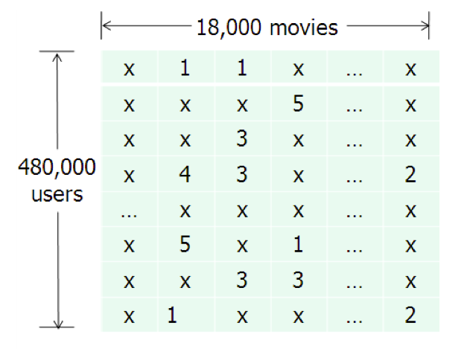
COLLABORATIVE FILTERING
This will be the general form of the data we analyse for collaborative filtering.
The method relies on previous user-item ratings (or feedback).

Slide 57
DIMENSIONALITY REDUCTION / LDA
DATA SCIENCE PART TIME COURSE

Slide 58

DIMENSIONALITY REDUCTION
A set of techniques for reducing the size (in terms of features,
records, and/or bytes) of the dataset under examination.
In general, the idea is to regard the dataset as a matrix and to decompose the matrix into simpler, meaningful pieces.

Slide 59
GOALS OF DIMENSIONALITY REDUCTION
We’d like to analyze the data using the most meaningful basis (or coordinates) possible.
More precisely: given an n x d matrix X (encoding n observations of a d-dimensional random variable), we want to find a k-dimensional representation of X (k < d) that captures the information in the original data, according to some criterion.

Slide 60
PRINCIPAL COMPONENTS
‘It finds a low-dimensional representation of a data set that contains as much as possible of the variation. The idea is that each of the n observations lives in p-dimensional space, but not all of these dimensions are equally interesting. PCA seeks a small number of dimensions that are as interesting as possible, where the concept of interesting is measured by the amount that the observations vary along each dimension. Each of the dimensions found by PCA is a linear combination of the p features.’
- Introduction to Statistical Learning

Slide 61
LINEAR DISCRIMINANT ANALYSIS
Slightly different to PCA (but very much related). Linear Discriminant Analysis (LDA) takes into account the class of an observation.
It aims to find a linear combination of features that separate two or more different classes.
Can be used as an alternative to Logistic Regression.

Slide 62
MODELLING CASE STUDY
DATA SCIENCE PART TIME COURSE

Slide 63
TEXT ANALYSIS
DATA SCIENCE PART TIME COURSE

Slide 64
WHAT IS TEXT ANALYSIS
Text is considered to be un-structured data. This means we don’t have nice features we can use as inputs. We will have to construct them using a model or rules we know about language.
When analysing text we need to consider what we actually want to use the text for
Sentiment Analysis
Topic Labelling
Classification

Slide 65

WHAT IS TEXT ANALYSIS?
Entity Extraction
Sentiment Analysis
Keyword Extraction
Concept Tagging
Relation Extraction
Taxonomy Classification
Author Extraction
Language Detection
Text Extraction
Microformats Parsing
Feed Detection
Linked Data Support

Slide 66
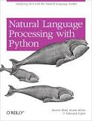
NATURAL LANGUAGE TOOLKIT (NLTK) - Python
NLTK is a leading platform for building Python programs to work with human language data. It provides easy-to-use interfaces to over 50 corpora and lexical resources such as WordNet, along with a suite of text processing libraries for classification, tokenization, stemming, tagging, parsing, and semantic reasoning, wrappers for industrial-strength NLP libraries, and an active discussion forum.

Slide 67
WEB SCRAPING
DATA SCIENCE PART TIME COURSE

Slide 68
WHAT IS WEB SCRAPING
Using a program to download and process a website
Lots of websites have API’s which can be used to collect data - START WITH THIS
If they don’t have an API you will need to download the material yourself (or get a freelancer to do it)

Slide 69
USEFUL LIBRARIES
urllib2: useful for fetching URLs and handling things like cookies and basic authentication
BeautifulSoup: great at extracting information from a page
Scrapy: Create web scraping routines

Slide 70
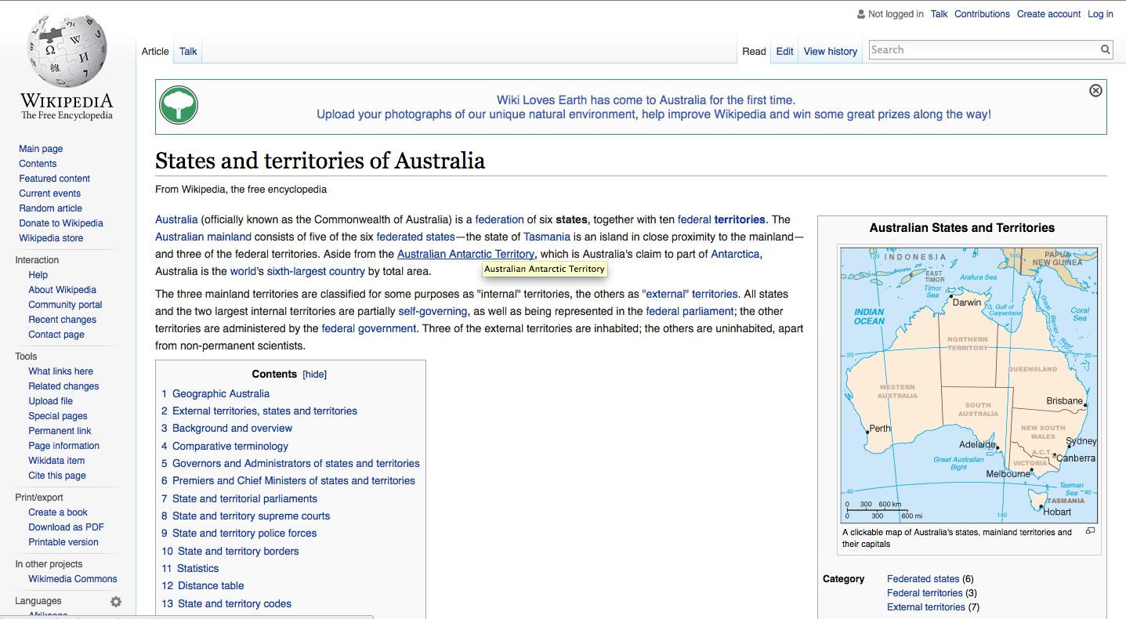

Slide 71
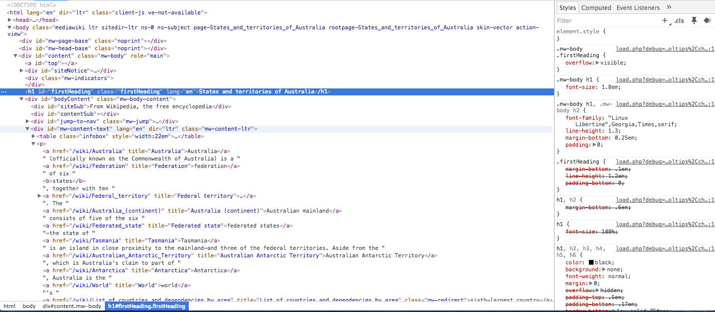

Slide 72
STEPS FOR SCRAPING
Figure out the URL (where to scrap from)
Query the website and fetch the HTML
Parse the website with something like Beautiful Soup
Query the dataset and extract the information of interest
Repeat

Slide 73
PREPPING DATA
DATA SCIENCE PART TIME COURSE

Slide 74
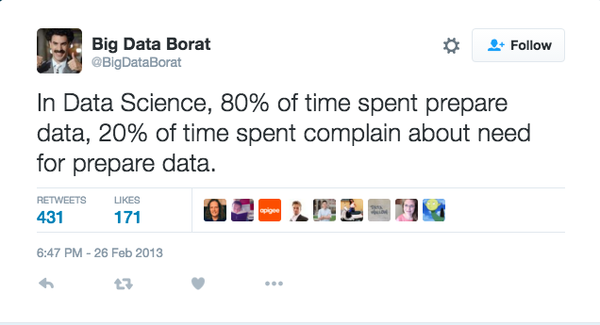
PREPARING DATA

Slide 75
PREPARING DATA
Every dataset is unique and will require it’s own approach to cleaning and preparation.
You will need to do some summaries as a basic ‘sniff test’, were you expecting the distributions of numeric variables? Were you expecting to have an overall count of some categories?
How many NA’s or missing variables do you have?
Am I using data from the future (relative to the observation)? This is information leakage and requires more thinking about the problem than data manipulation.

Slide 76
MISSING DATA IMPUTATION
You usually don’t want to exclude a variable because it has a missing value in the column
To include it most algorithms require all values be non-NA’s
The best way to impute data is dependent on the problem (but it’s usually not a good idea to fill it with the average).
An excellent library in R for missing data is Amelia

Slide 77
GEODATA HANDLING
DATA SCIENCE PART TIME COURSE

Slide 78
MORE LEARNING
Udacity Deep Learning Course by Google - https://www.udacity.com/course/deep-learning--ud730
Gaussian Process Models - http://www.gaussianprocess.org/gpml/
Great Podcast - http://www.thetalkingmachines.com/
DATA SCIENCE - Week 7 Day 3

Slide 79
COURSE REMAINDER
Cloud Computing
Time Series
Graph Analysis
Neural Networks
Natural Language Processing
Communication Skills and Job Market Overview
Project Presentations (Final 2 sessions)
DATA SCIENCE - Week 7 Day 3

